Slide 1
Lecture 11:
Graph Data Mining
Slides are modified from Jiawei Han & Micheline Kamber

Slide 2
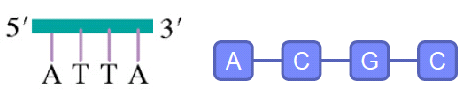
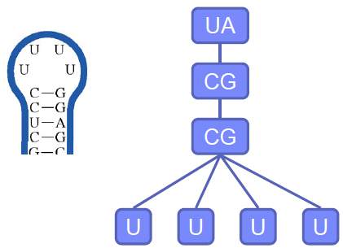
Graph Data Mining
DNA sequence
RNA

Slide 3
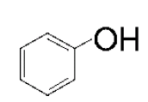
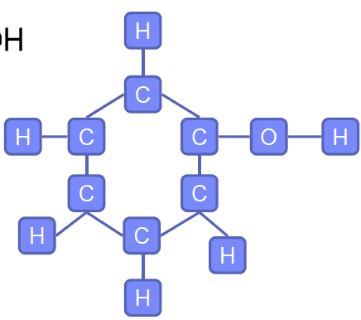
Graph Data Mining
Compounds
Texts

Slide 4
Outline
Graph Pattern Mining
  Mining Frequent Subgraph Patterns
  Graph Indexing
  Graph Similarity Search
Graph Classification
  Graph pattern-based approach
  Machine Learning approaches
Graph Clustering
  Link-density-based approach

Slide 5
Graph Pattern Mining
Frequent subgraphs
  A (sub)graph is frequent if its support (occurrence frequency) in a given dataset is no less than a minimum support threshold
Support of a graph g is defined as the percentage of graphs in G which have g as subgraph
Applications of graph pattern mining
  Mining biochemical structures
  Program control flow analysis
  Mining XML structures or Web communities
  Building blocks for graph classification, clustering, compression, comparison, and correlation analysis

Slide 6
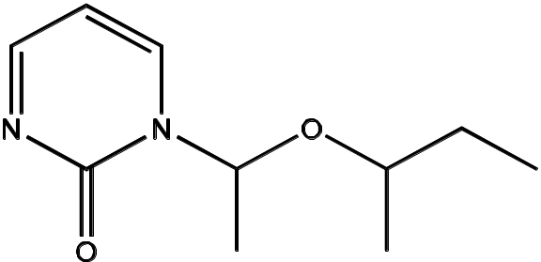
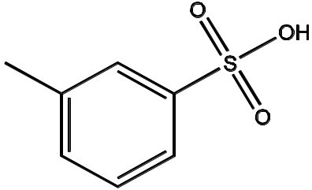
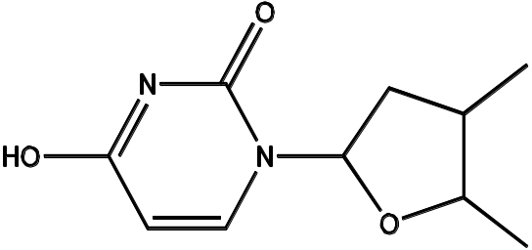
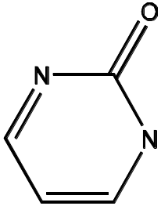
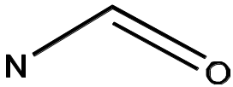
Example: Frequent Subgraphs
GRAPH DATASET
(A)
(B)
(C)
FREQUENT PATTERNS
(MIN SUPPORT IS 2)
(1)
(2)

Slide 7
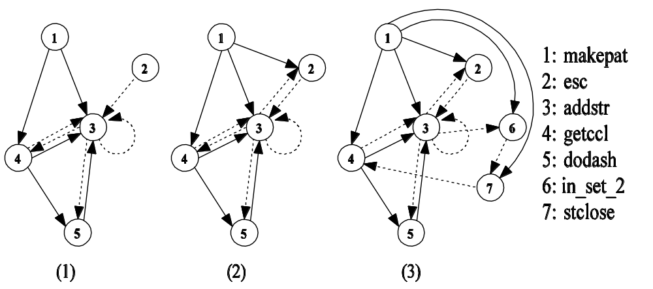
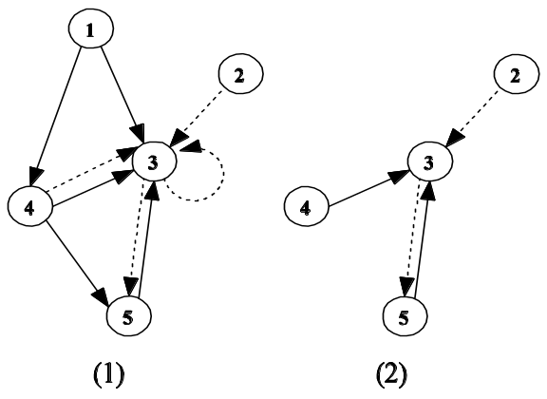
Example
GRAPH DATASET
FREQUENT PATTERNS
(MIN SUPPORT IS 2)

Slide 8
Graph Mining Algorithms
Incomplete beam search – Greedy (Subdue)
Inductive logic programming (WARMR)
Graph theory-based approaches
  Apriori-based approach
  Pattern-growth approach

Slide 9
Properties of Graph Mining Algorithms
Search order
  breadth vs. depth
Generation of candidate subgraphs
  apriori vs. pattern growth
Elimination of duplicate subgraphs
  passive vs. active
Support calculation
  embedding store or not
Discover order of patterns
  path → tree → graph

Slide 10
Apriori-Based Approach
(k+1)-edge
k-edge
G₁
G₁
G
G₂
G’
…
Subgraph isomorphism test
NP-complete
G’’
G_{n}
G_{n}
Join
Prune
check the frequency of
each candidate

Slide 11
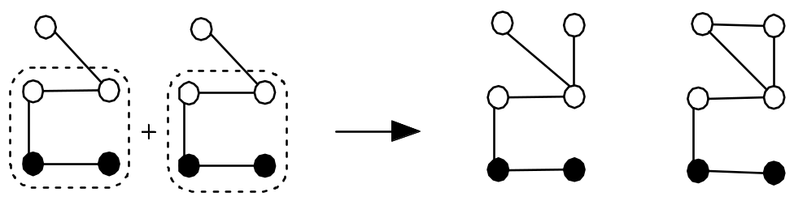
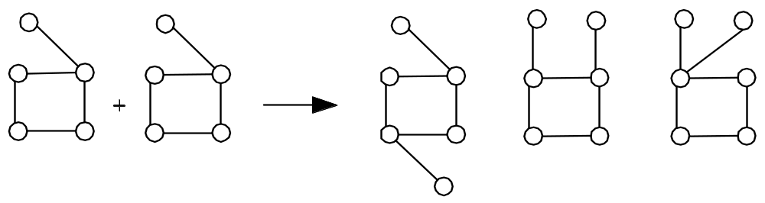
Apriori-Based, Breadth-First Search
Methodology: breadth-search, joining two graphs
AGM (Inokuchi, et al.)
  generates new graphs with one more node
FSG (Kuramochi and Karypis)
  generates new graphs with one more edge

Slide 12
Pattern Growth Method
(k+2)-edge
(k+1)-edge
G₁
…
k-edge
G₂
duplicate
graph
G
…
G_{n}
…
Notes:
Apriori:
Step1: Join two k-1 edge graphs (these two graphs share a same k-2 edge subgraph) to generate a k-edge graph
Step2: Join the tid-list of these two k-1 edge graphs, then see whether its count is larger than the minimum support
Step3: Check all k-1 subgraph of this k-edge graph to see whether all of them are frequent
Step4: After G successfully pass Step1-3, do support computation of G in the graph dataset, See whether it is really frequent.
gSpan:
Step1: Right-most extend a k-1 edge graph to several k edge graphs.
Step2: Enumerate the occurrence of this k-1 edge graph in the graph dataset, meanwhile, counting these k edge graphs.
Step3: Output those k edge graphs whose support is larger than the minimum support.
Pros:
1: gSpan avoid the costly candidate generation and testing some infrequent subgraphs.
2: No complicated graph operations, like joining two graphs and calculating its k-1 subgraphs.
3. gSpan is very simple
The key is how to do right most extension efficiently in graph. We invented DFS code for graph.

Slide 13
Graph Pattern Explosion Problem
If a graph is frequent, all of its subgraphs are frequent
  the Apriori property
An n-edge frequent graph may have 2^{n} subgraphs
Among 422 chemical compounds which are confirmed to be active in an AIDS antiviral screen dataset,
  there are 1,000,000 frequent graph patterns if the minimum support is 5%

Slide 14
Closed Frequent Graphs
A frequent graph G is closed
  if there exists no supergraph of G that carries the same support as G
If some of G’s subgraphs have the same support
  it is unnecessary to output these subgraphs
  nonclosed graphs
Lossless compression
  Still ensures that the mining result is complete

Slide 15
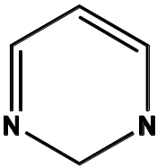


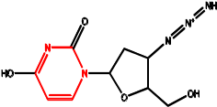
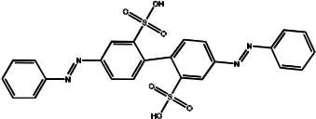
Graph Search
Querying graph databases:
  Given a graph database and a query graph, find all the graphs containing this query graph
query graph
graph database

Slide 16
Scalability Issue
Naïve solution
  Sequential scan (Disk I/O)
  Subgraph isomorphism test (NP-complete)
Problem: Scalability is a big issue
An indexing mechanism is needed

Slide 17
Indexing Strategy
Query graph (Q)
Graph (G)
If graph G contains query graph Q, G should contain any substructure of Q
Substructure
Remarks
  Index substructures of a query graph to prune graphs that do not contain these substructures
Notes:
Our work, also with all the previous work follows this indexing strategy.

Slide 18
Indexing Framework
Two steps in processing graph queries
Step 1. Index Construction
  Enumerate structures in the graph database, build an inverted index between structures and graphs
Step 2. Query Processing
  Enumerate structures in the query graph
  Calculate the candidate graphs containing these structures
  Prune the false positive answers by performing subgraph isomorphism test

Slide 19
Why Frequent Structures?
We cannot index (or even search) all of substructures
Large structures will likely be indexed well by their substructures
Size-increasing support threshold
minimum
support threshold
support
size

Slide 20
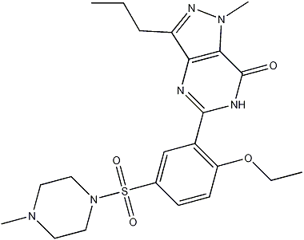
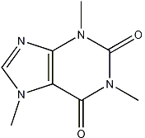
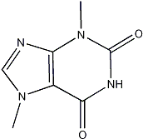
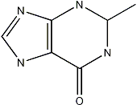
Structure Similarity Search
CHEMICAL COMPOUNDS
(a) caffeine
(b) diurobromine
(c) sildenafil
QUERY GRAPH

Slide 21
Substructure Similarity Measure
Feature-based similarity measure
  Each graph is represented as a feature vector
    X = {x₁, x₂, …, x_{n}}
  Similarity is defined by the distance of their corresponding vectors
  Advantages
    Easy to index
    Fast
    Rough measure

Slide 22
Some “Straightforward” Methods
Method1: Directly compute the similarity between the graphs in the DB and the query graph
  Sequential scan
  Subgraph similarity computation
Method 2: Form a set of subgraph queries from the original query graph and use the exact subgraph search
  Costly: If we allow 3 edges to be missed in a 20-edge query graph, it may generate 1,140 subgraphs

Slide 23
Index: Precise vs. Approximate Search
Precise Search
  Use frequent patterns as indexing features
  Select features in the database space based on their selectivity
  Build the index
Approximate Search
  Hard to build indices covering similar subgraphs
    explosive number of subgraphs in databases
  Idea: (1) keep the index structure
    (2) select features in the query space

Slide 24
Outline
Graph Pattern Mining
  Mining Frequent Subgraph Patterns
  Graph Indexing
  Graph Similarity Search
Graph Classification
  Graph pattern-based approach
  Machine Learning approaches
Graph Clustering
  Link-density-based approach

Slide 25




Substructure-Based Graph Classification
Basic idea
  Extract graph substructures
  Represent a graph with a feature vector ,
    where is the frequency of in that graph
  Build a classification model
Different features and representative work
  Fingerprint
  Maccs keys
  Tree and cyclic patterns [Horvath et al.]
  Minimal contrast subgraph [Ting and Bailey]
  Frequent subgraphs [Deshpande et al.; Liu et al.]
  Graph fragments [Wale and Karypis]

Slide 26
Direct Mining of Discriminative Patterns
Avoid mining the whole set of patterns
  Harmony [Wang and Karypis]
  DDPMine [Cheng et al.]
  LEAP [Yan et al.]
  MbT [Fan et al.]
Find the most discriminative pattern
  A search problem?
  An optimization problem?
Extensions
  Mining top-k discriminative patterns
  Mining approximate/weighted discriminative patterns

Slide 27
Graph Kernels
Motivation:
  Kernel based learning methods doesn’t need to access data points
    They rely on the kernel function between the data points
  Can be applied to any complex structure provided you can define a kernel function on them
Basic idea:
  Map each graph to some significant set of patterns
  Define a kernel on the corresponding sets of patterns

Slide 28
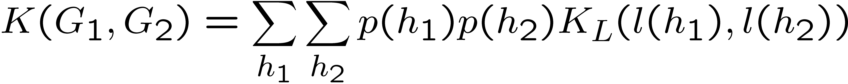
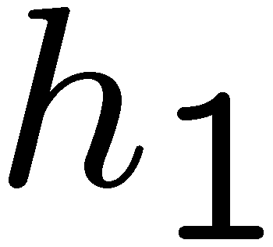
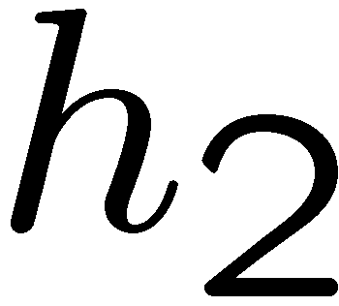
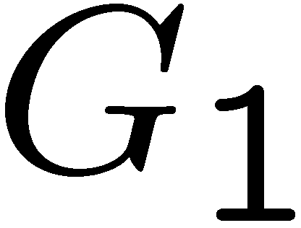
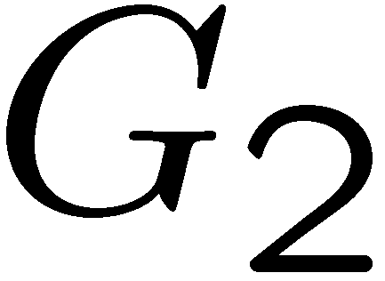
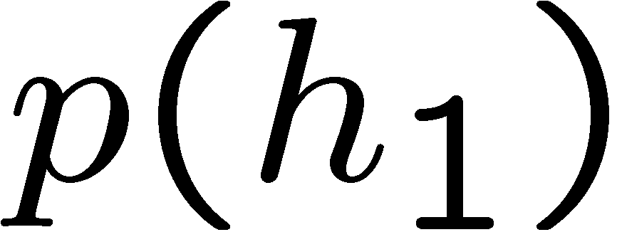
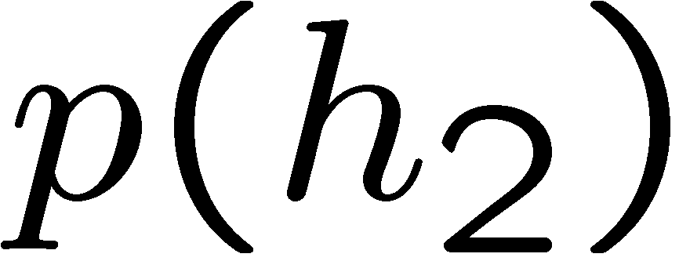
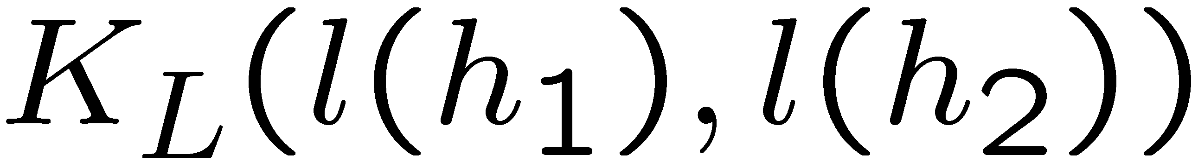
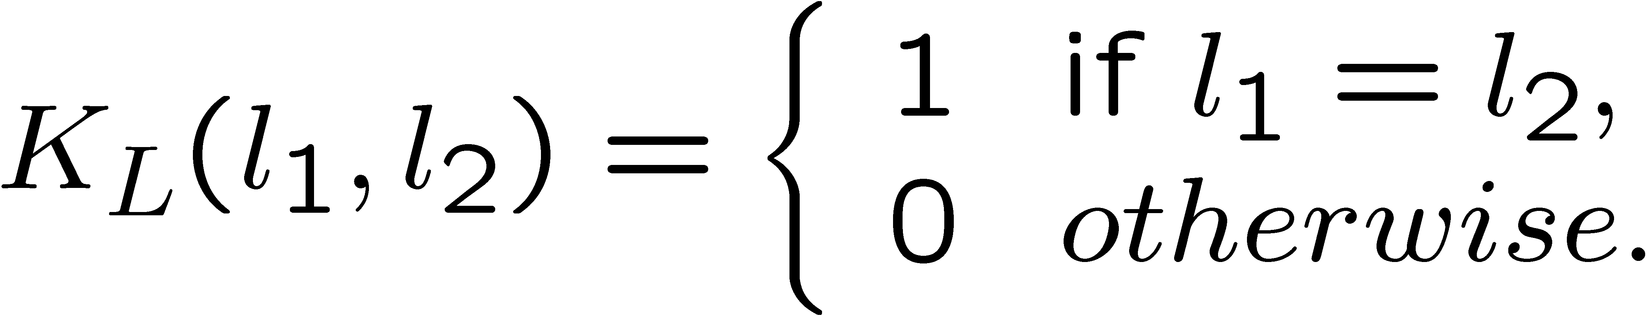
Kernel-based Classification
  Random walk
    Basic Idea: count the matching random walks between the two graphs
  Marginalized Kernels
    Gärtner ’02, Kashima et al. ’02, Mahé et al.’04
    and are paths in graphs and
    and are probability distributions on paths
    is a kernel between paths, e.g.,

Slide 29
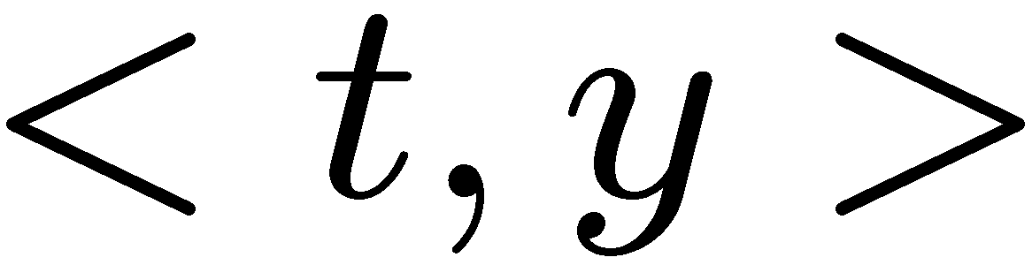


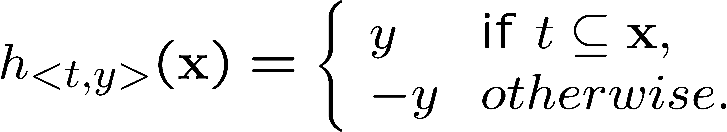
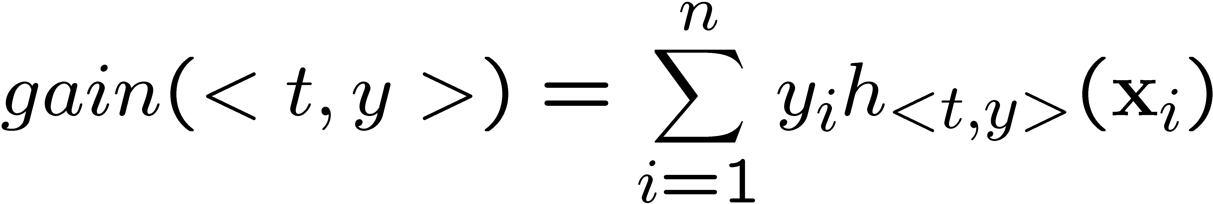
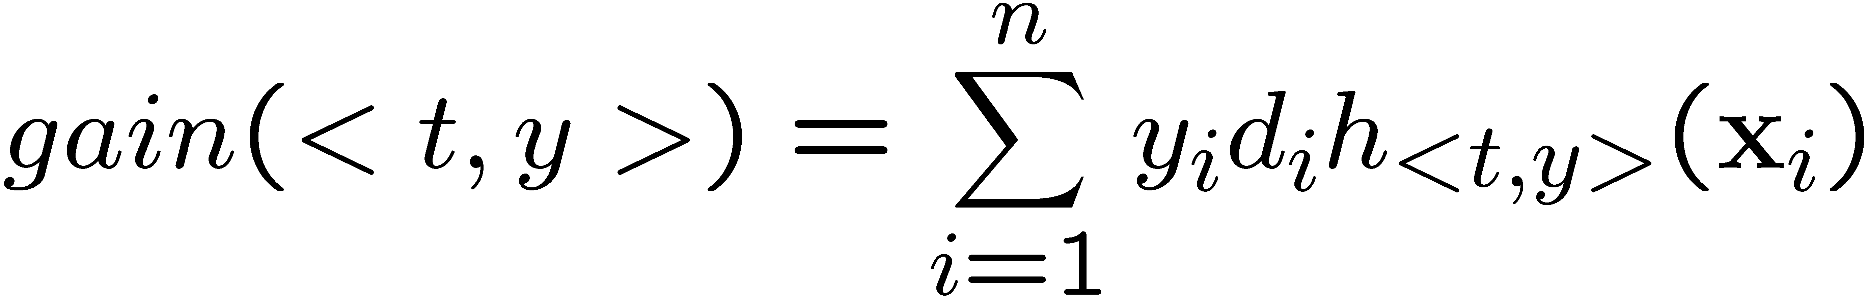
Boosting in Graph Classification
Decision stumps
  Simple classifiers in which the final decision is made by single features
  A rule is a tuple
    If a molecule contains substructure , it is classified as .
  Gain
  Applying boosting

Slide 30
Outline
Graph Pattern Mining
  Mining Frequent Subgraph Patterns
  Graph Indexing
  Graph Similarity Search
Graph Classification
  Graph pattern-based approach
  Machine Learning approaches
Graph Clustering
  Link-density-based approach

Slide 31
Graph Compression
Extract common subgraphs and simplify graphs by condensing these subgraphs into nodes

Slide 32
Graph/Network Clustering Problem
Networks made up of the mutual relationships of data elements usually have an underlying structure
  Because relationships are complex, it is difficult to discover these structures.
    How can the structure be made clear?
Given simple information of who associates with whom, could one identify clusters of individuals with common interests or special relationships?
  E.g., families, cliques, terrorist cells…

Slide 33
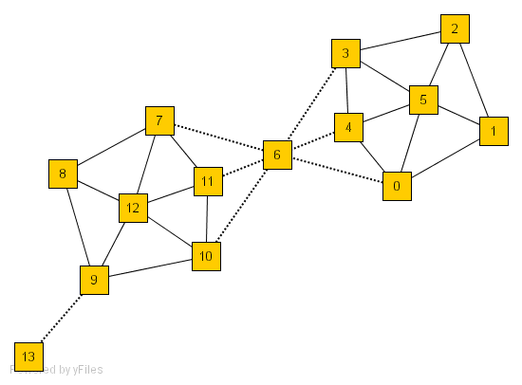
An Example of Networks
How many clusters?
What size should they be?
What is the best partitioning?
Should some points be segregated?

Slide 34
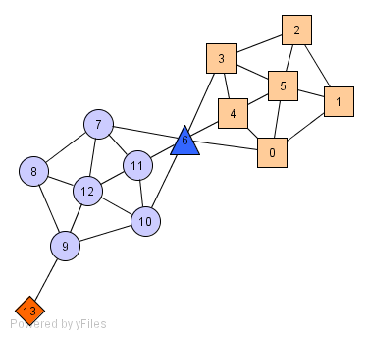
A Social Network Model
Individuals in a tight social group, or clique, know many of the same people
  regardless of the size of the group
Individuals who are hubs know many people in different groups but belong to no single group
  E.g., politicians bridge multiple groups
Individuals who are outliers reside at the margins of society
  E.g., Hermits know few people and belong to no group

Slide 35
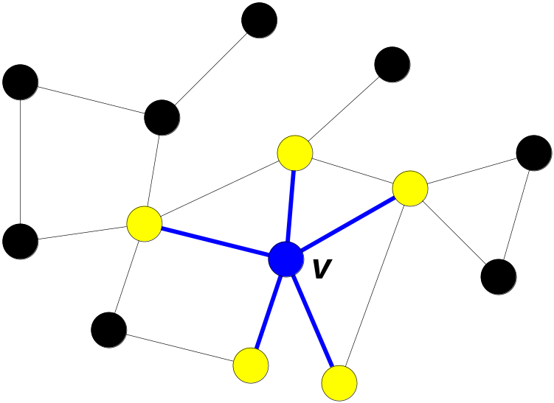
The Neighborhood of a Vertex
Define Γ(ν) as the immediate neighborhood of a vertex
  i.e. the set of people that an individual knows

Slide 36
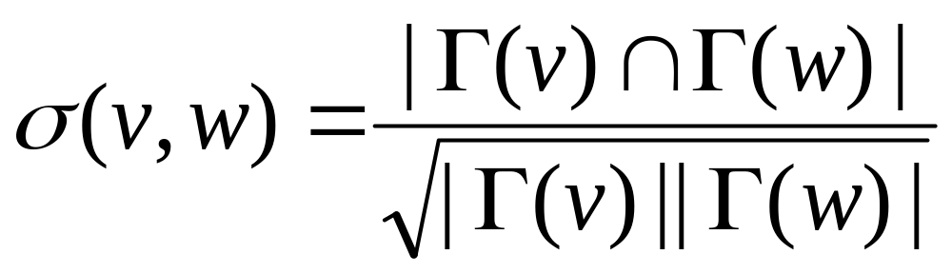
Structure Similarity
The desired features tend to be captured by a measure called Structural Similarity
Structural similarity is large for members of a clique and small for hubs and outliers.

Slide 37
Graph Mining
Frequent Subgraph
Mining (FSM)
Variant Subgraph
Pattern Mining
Applications of
Frequent Subgraph
Mining
Pattern
Growth
based
Indexing
and
Search
Clustering
Apriori
based
Approximate
methods
Coherent
Subgraph
mining
Closed
Subgraph
mining
Dense
Subgraph
Mining
Classification
GraphGrep Daylight gIndex
(Є Grafil)
gSpan MoFa GASTON FFSM SPIN
AGM FSG PATH
SUBDUE GBI
CSA CLAN
Kernel Methods (Graph Kernels)
CloseGraph
CloseCut Splat CODENSE

